Slide 1
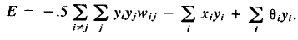
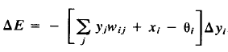
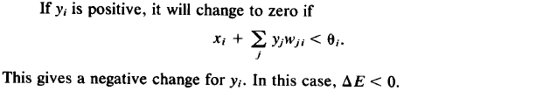
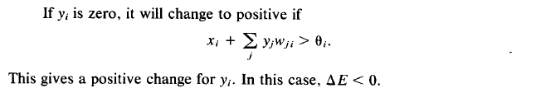

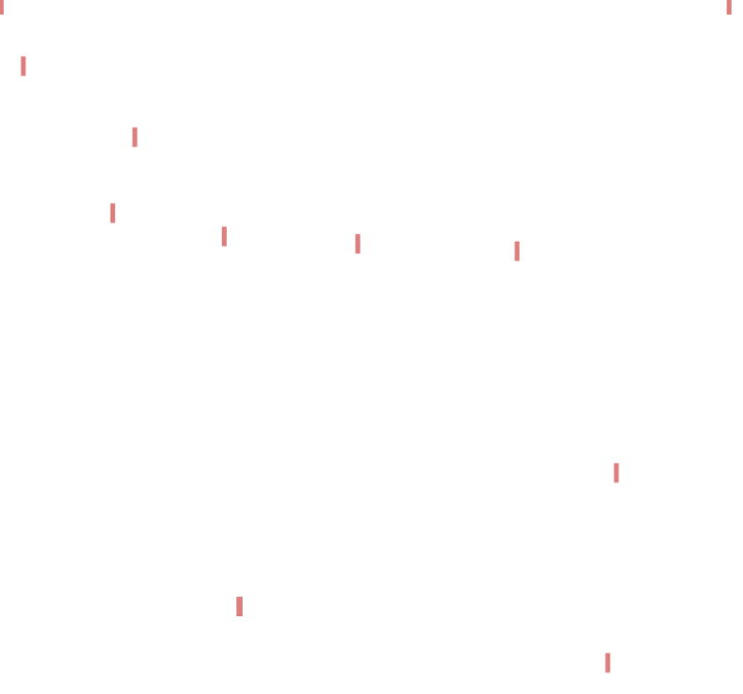
Proof:
Consider following Energy Function
The Energy Function has a limited lower bound

Slide 2
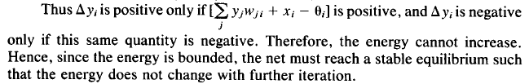
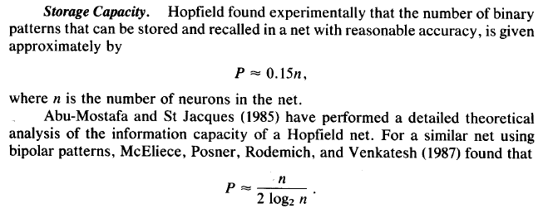


Slide 3

Capacity of one layer MNN in restoring input patterns
For n-dimensional orthogonal input patterns
Auto-Associative Bipolar patterns | Hetro-Associative | Weight Matrix
“Capacity =n” | “Capacity =n” | Hebbian Matrix
“Capacity =n-1” | - | Modified Hebbian Matrix
Two important notes
For Auto-associative MNNs each stored vector is an Eigen-vector of the weight matrix of the network.
If additive disturbance of an input pattern (with arbitrary norm) are defined in nullity space of the weight matrix, the network will have unlimited robustness against it. Hence, it is suggested to use a low percentage of the whole capacity for restoring patterns.

Slide 4
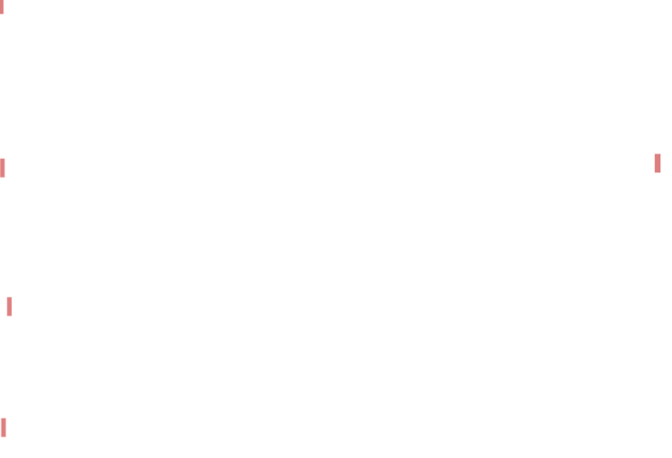
How to utilize Hebbian Memory Networks for (1) non-orthogonal, (2) analogue input patterns (3) with high enough capacity?
For Arbitrary number of non-orthogonal analogue inputs:
(1) Provide a transformation function to generate bipolar patterns from input analogue patterns.
The dimension of the bipolar patterns must be more than or equal to the number of input patterns
The generated bipolar patterns must be linearly independent form each other.
the order of distances of any analogue input pattern with all other input patterns must be seen in bipolar patterns, too.
(2) Provide a transformation matrix to get orthogonal bipolar form of the former generated bipolar patterns.
(3) Use Hebbian Learning Rule to store the required patterns

Slide 5
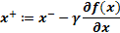

Restoring arbitrary number of patterns without dimension extending and orthogonal transformation
Assume it is aimed to train a network which associate different input patterns {S_{i} i=1,2..,P} to target patterns {t_{i} i=1,2..,P} .
Define a nonlinear scalar function with n-dimensional input variable: y=f(x). Such function must have at least “P” local minimum points :{y=f_{i} i=1,2..,P} at {x=S_{i} i=1,2..,P} .
Assume that each local minimum point (y=f_{i}) denotes the output patterns (t_{i}) and for two equal (not equal) output patterns two corresponding levels are equal (not equal) .
Now define a network which has two sequenced parts. At the First part the Network in a recurrent structure updates the input pattern by Gradient descent of the defined function. At the second part the Network produce the output of the function based on the updated input (by the first part).
It is expected that the network at first part converges to an input pattern (S_{j}) and in the second part (f_{j}) will be appeared which is considered as a label for (t_{j}).

